Slide 1
Compressed Hashmap Dictionary
CPE 593, Spring 2023
Parveen (Zahra), Eugene Kozlakov, Yihang Yuan

Slide 2
Intro to HashTrie

Slide 3
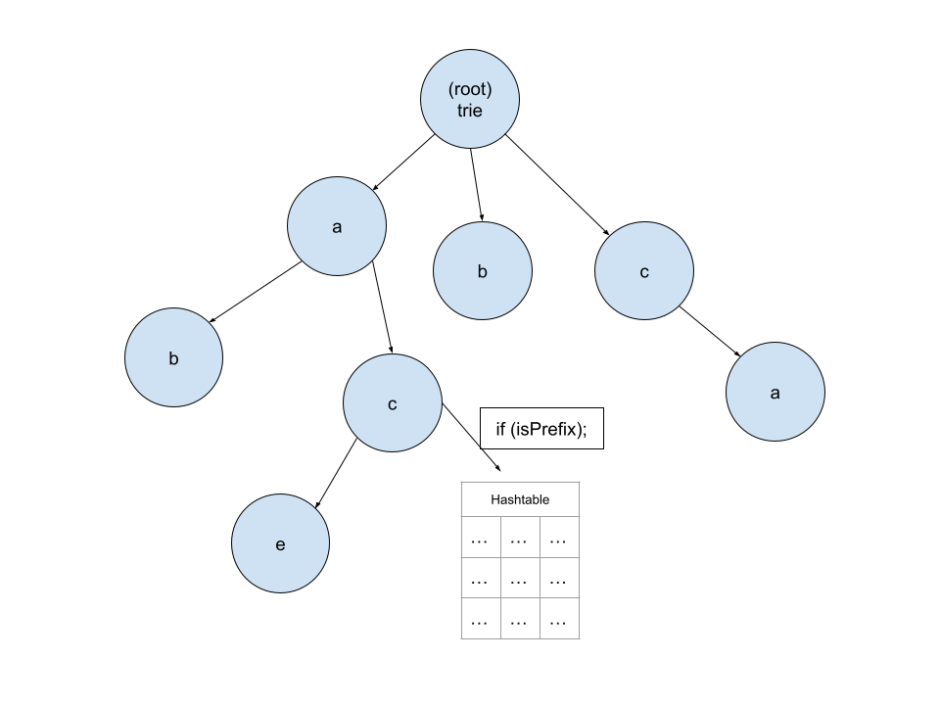
Basic Structure

Slide 4
Use Case and Applications
Databases
Dictionaries and Symbol Tables
Language and Compiler Implementations
Persistent Caches
Trie-Based Search
Popularity is due to its versatility and efficiency
Notes:
Databases - They provide fast lookups, insertions, and deletions, making them suitable for efficient data retrieval and management.
Dictionaries and Symbol Tables - They provide fast lookups, insertions, and deletions, making them suitable for efficient data retrieval and management.
Language and Compiler Implementations - They can be employed for storing symbol tables, managing variable and function names, and performing lexical analysis and parsing tasks efficiently.
Persistent Caches - They allow efficient storage and retrieval of cached data by utilizing key-value mappings, enabling fast access to frequently accessed data.
Trie-Based Search - They provide efficient prefix search and traversal operations, making them suitable for autocomplete systems, spell checkers, and text indexing.

Slide 5
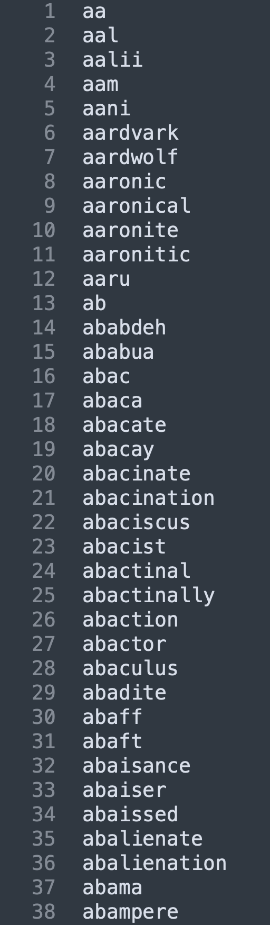
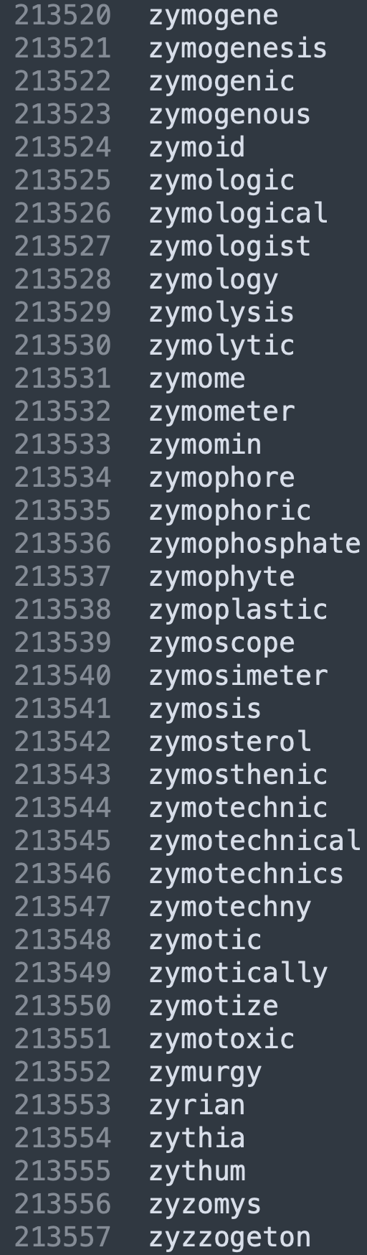

Loading the Dictionary
。。。
dict.txt

Slide 6
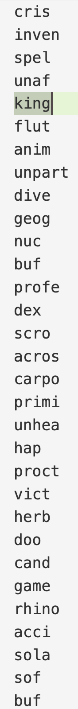
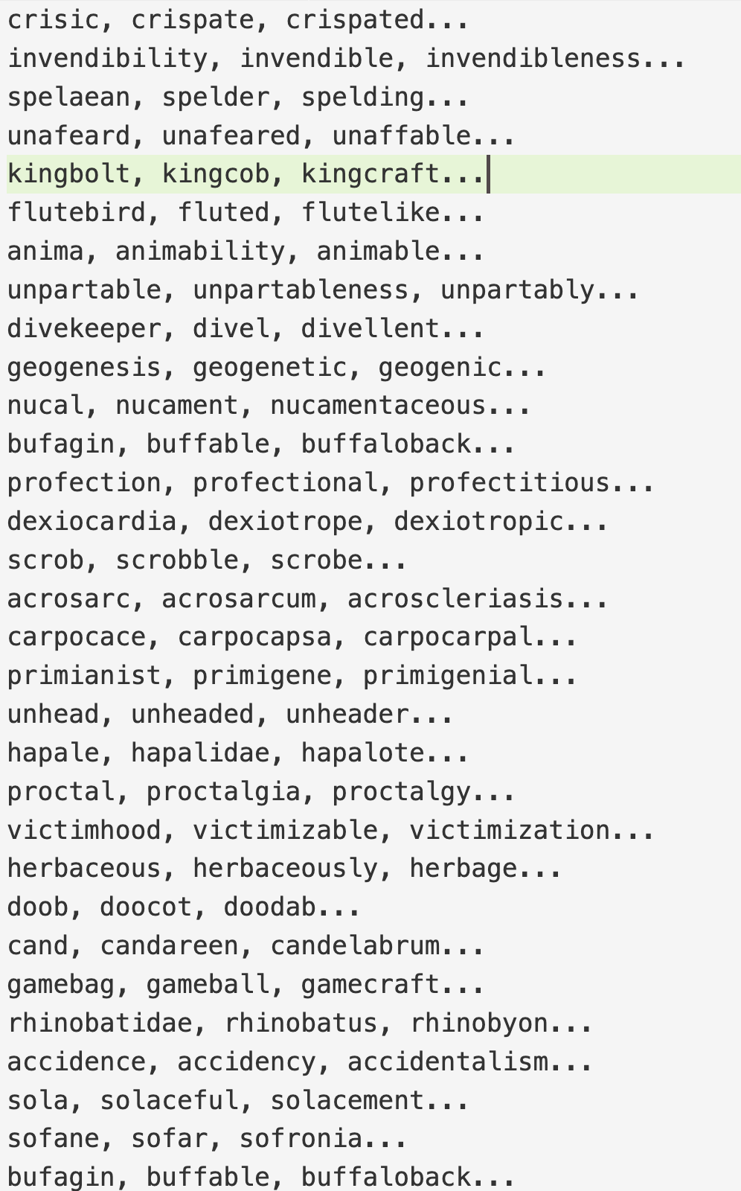
what we need:
prefix
words
constrain:
kingbolt
kingcob
kingcraft
kingcup
kingdomed
kingdomful
kingdomless
kingdomship
kingfish
kinghead
kinghood
kinghunter
kingless
kinglessness
kinglihood
kinglike
kinglily
kingliness
kingling
kingly
kingmaker
kingmaking
kingpiece
kingrow
kingship
kingsman
kingu
kingweed
kingwood
quantity = 29 < threshold = 64

Slide 7

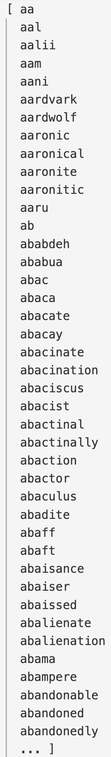
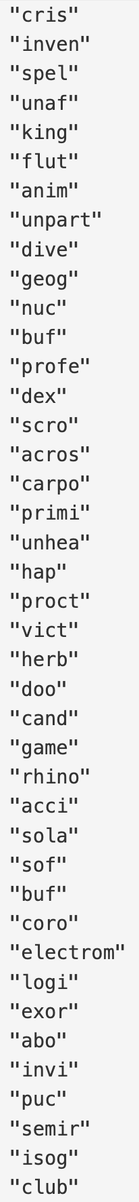
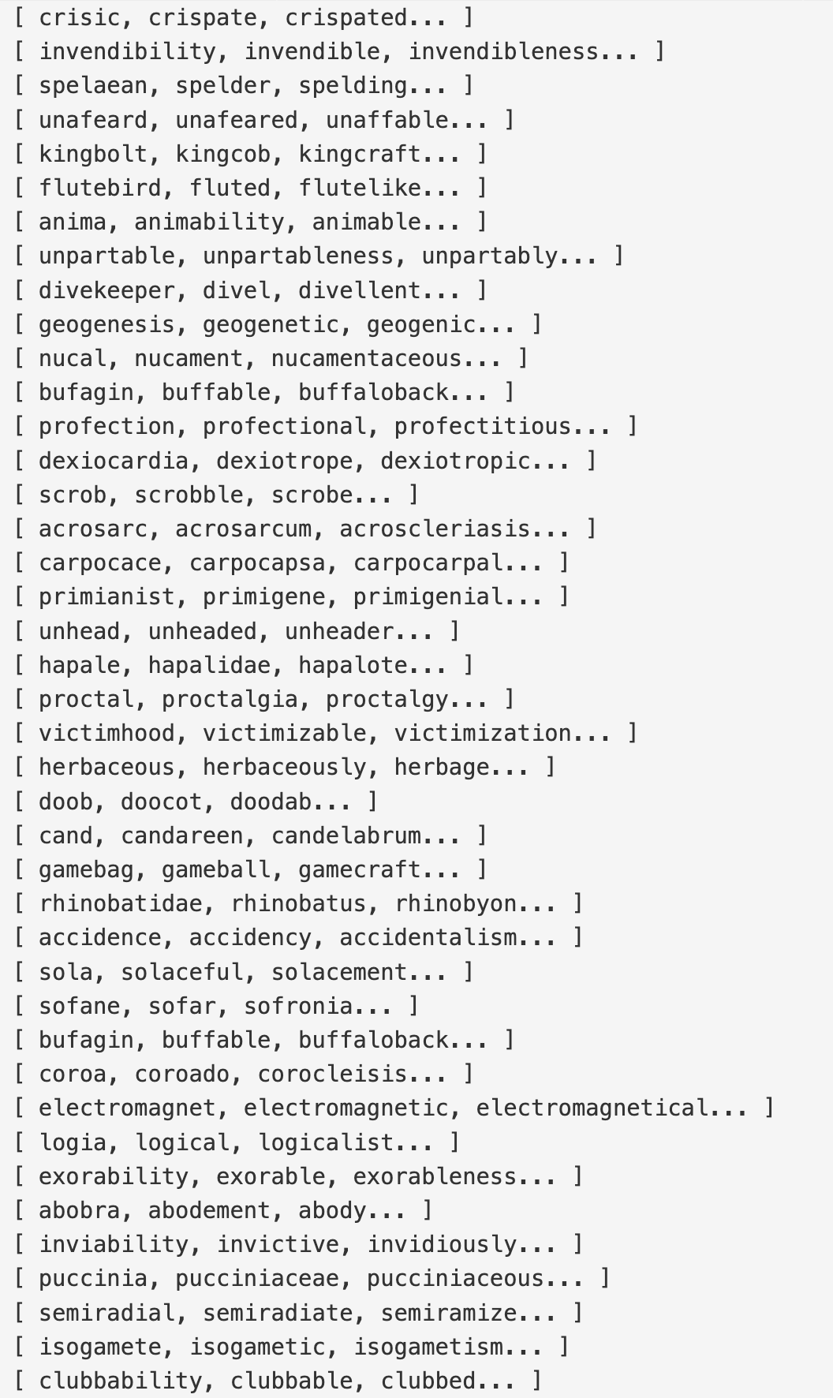

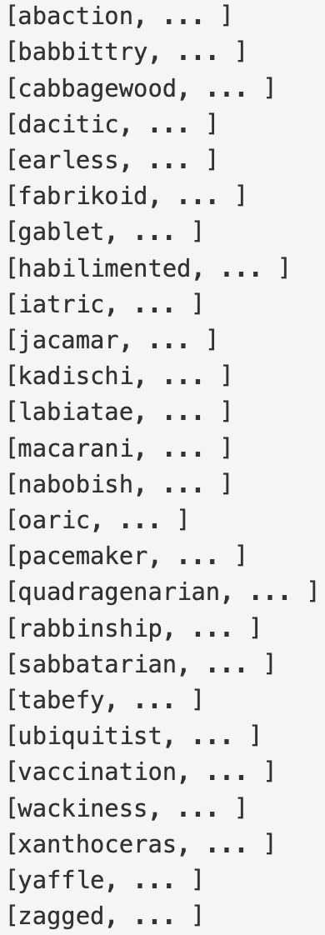
Unordered_Map
Unorderd_Map
key : value
key : value
Prefix Partitioning Algorithm
Unordered_Map
key : value
dict.txt

Slide 8
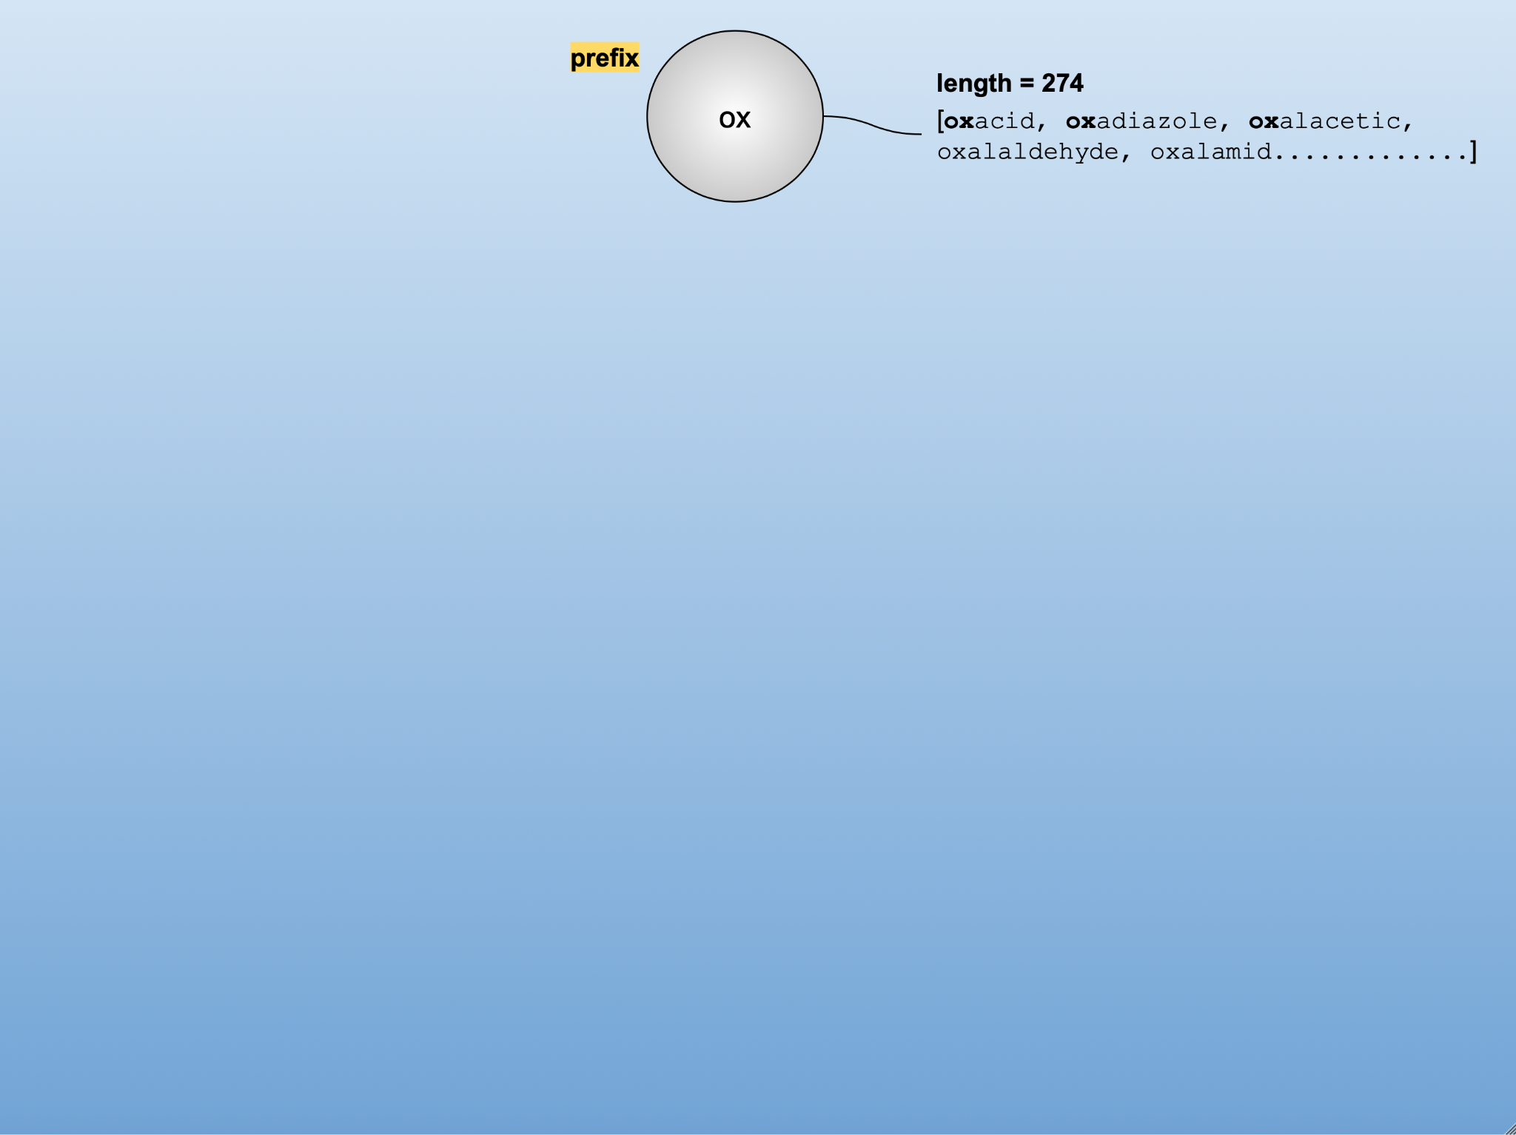
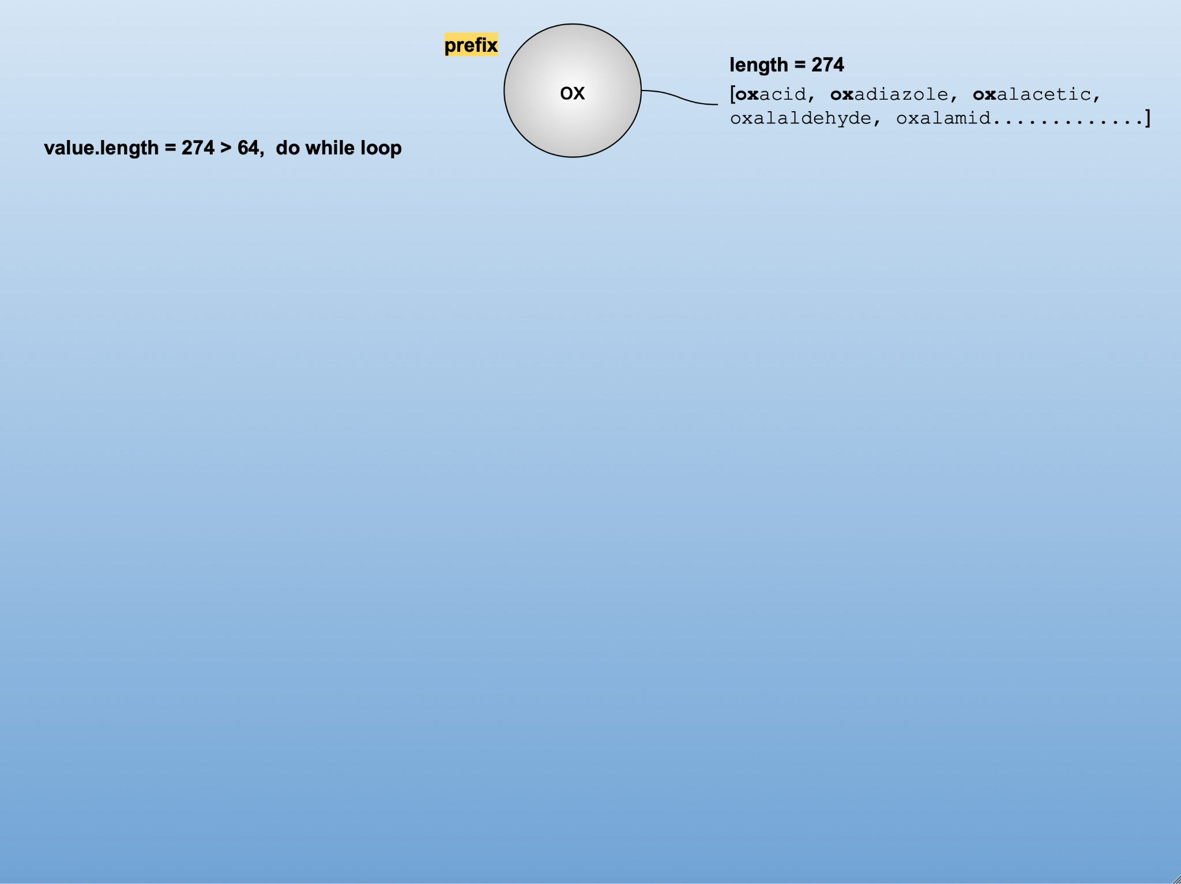
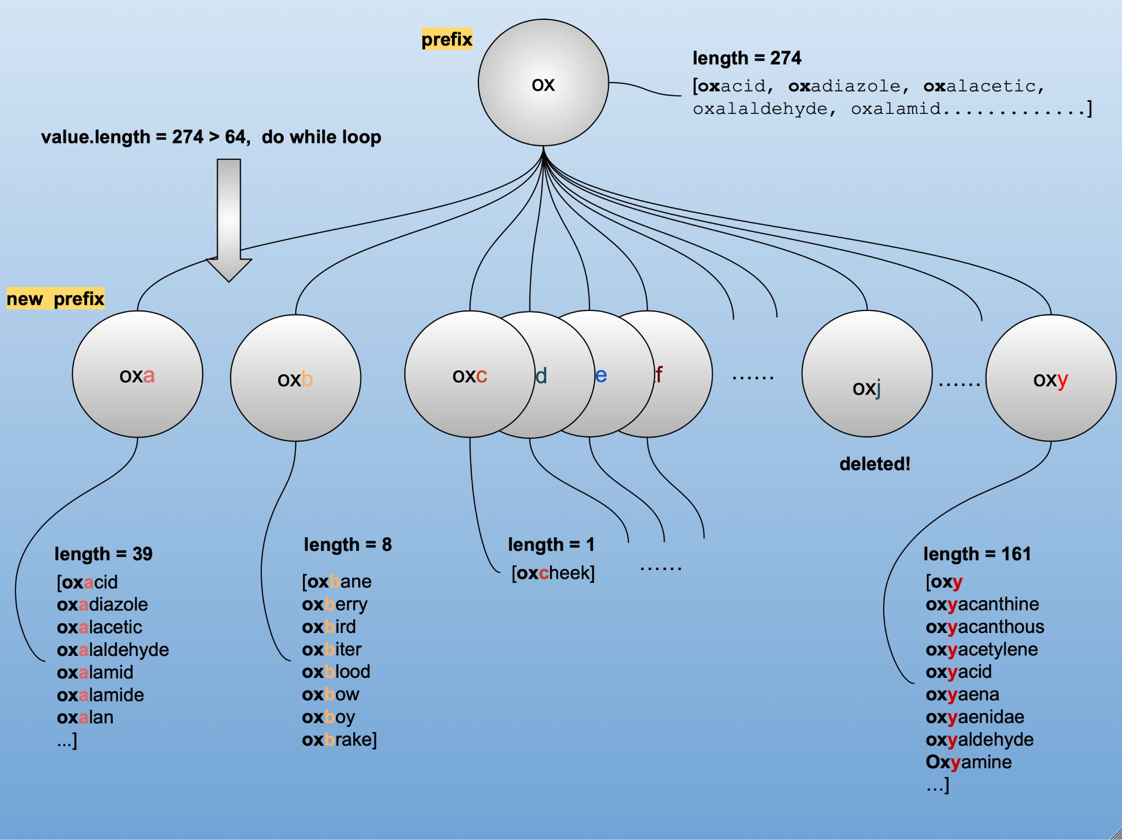
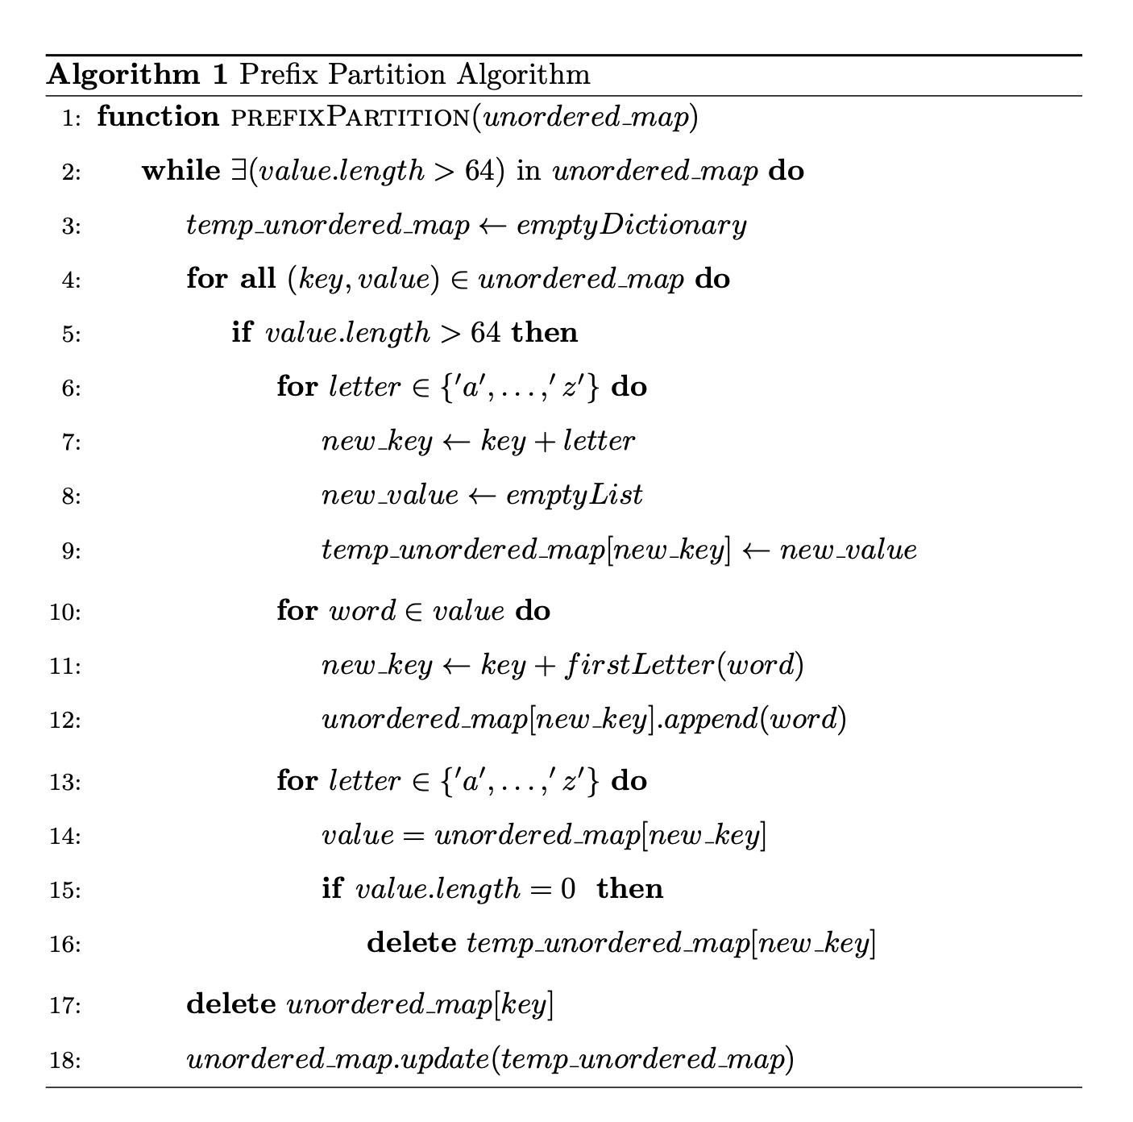

Slide 9
Functionality (Algorithm)
Once we have the unordered map of prefix “keys” with their subsequent word “values”, we:
Map all prefixes (keys) to the Trie
At leaf node of prefix:
Set “isPrefix == true”;
establish new unordered_map<unsigned long, string> (hashtable) pointing from leaf node of prefix in Trie
Cycle through each value in unordered_map<string, vector<string>> dictionary for the current key (prefix) and hash to the newly setup hashtable.
Once mapping is complete, cycle to next key (prefix) in unordered_map<string, vector<string>> dictionary and return to step (1.)

Slide 10
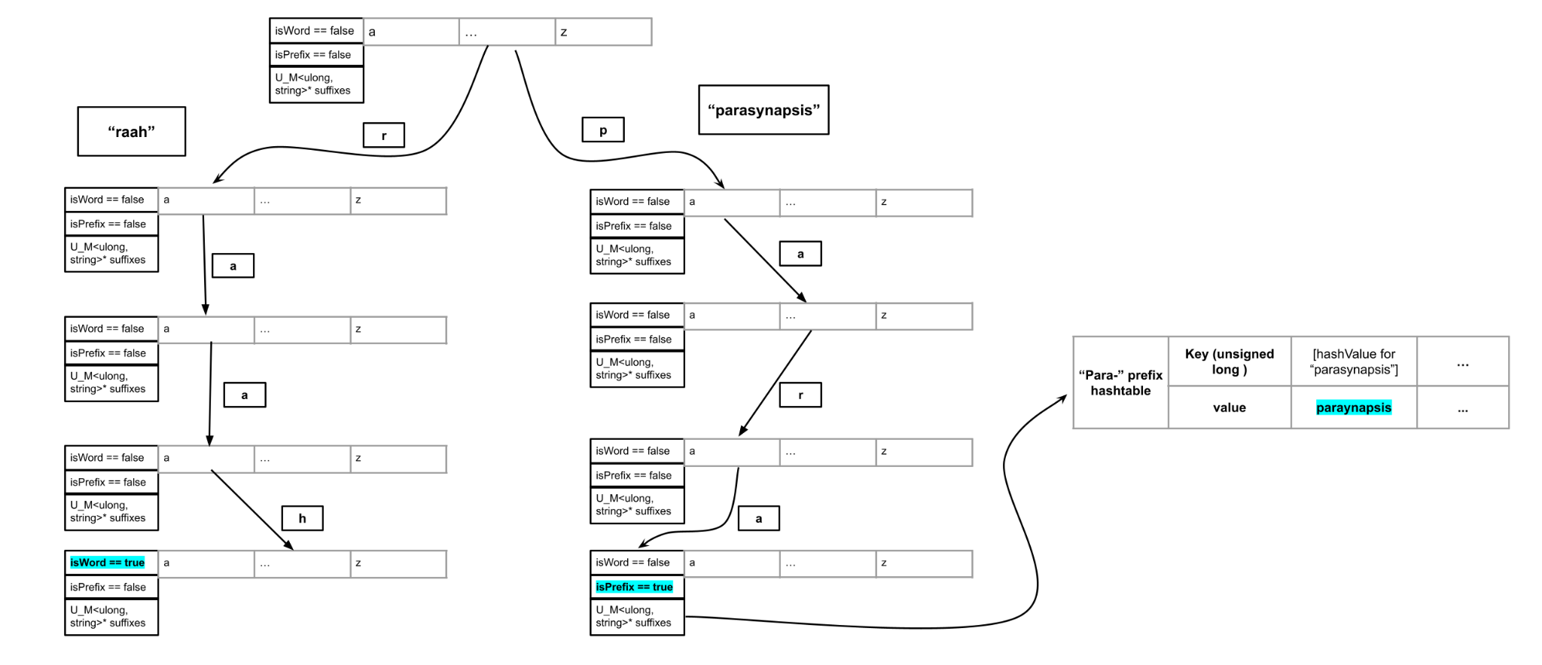
Basic Structure

Slide 11
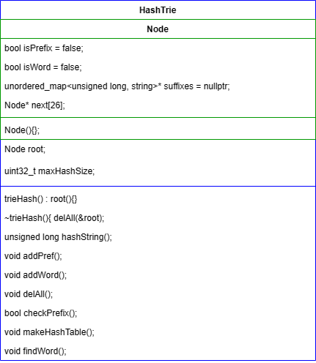
Functionality

Slide 12
Benchmarking
Zahra(Parveen)

Slide 13
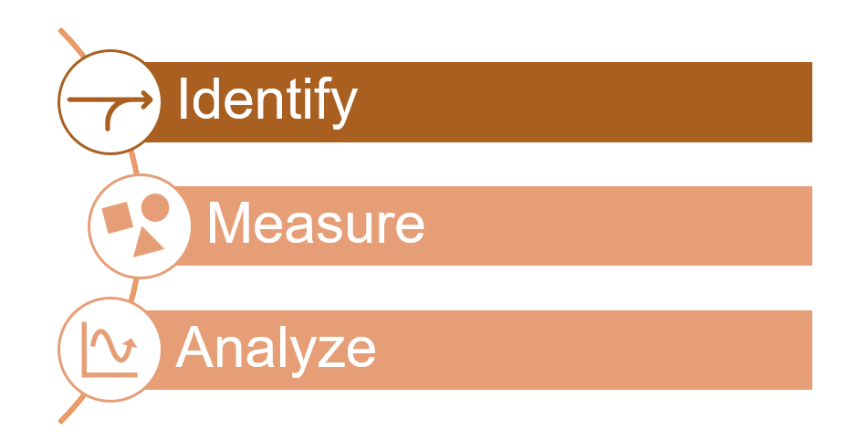
Benchmarking Approach
Notes:
Identify:
Measure:
Analyse:

Slide 14
Benchmark Results
#include <chrono>
auto start = std::chrono::high_resolution_clock::now();
//first we break down the dictionary into a hashtable (unorderded map) of prefixes (keys)
// and a list of the subsequent suffixes (values.)
func()
auto endBreaker = std::chrono::high_resolution_clock::now();
std::chrono::duration<double, std::micro> duration = endBreaker - start;
std::cout << " breaker() call benchmark duration for dictionary: " << duration.count() << " microseconds" << std::endl;
breaker() call benchmark duration for dictionary: 6.542 microseconds
mapping (.addWord, .addPref, and .makeHashTable) benchmark duration for dictionary: 1.262 microseconds
[parasy] has *NOT* been found in the dictionary.
prefix search (trie traversal) benchmark duration for dictionary: 2.315 microseconds
[parasynapsis] has *NOT* been found in the dictionary.
word search (trie traversal and hash access) benchmark duration for dictionary: 1.723 microseconds
word add (pure trie mapping) benchmark duration for dictionary: 2.184 microseconds
word search (pure trie traversal) benchmark duration for dictionary: 0.39 microseconds
word add (trie traversal and hash access) benchmark duration for dictionary: 0.912 microseconds
word search (trie traversal and hash access) benchmark duration for dictionary: 0.34 microseconds

Slide 15
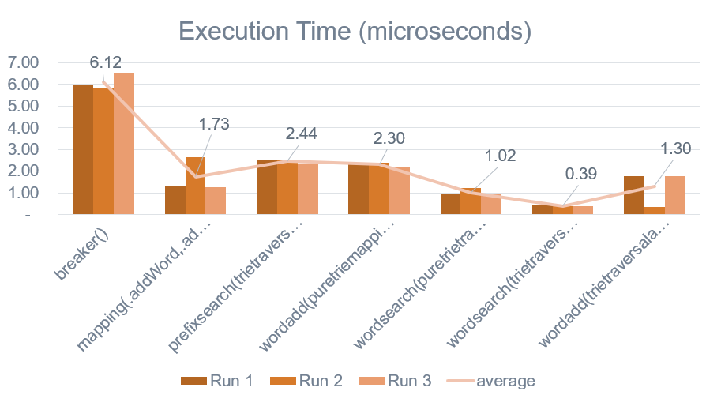
Benchmark Output
Function Name | Average of Duration (microseconds) | Number of Executions/Runs
breaker() | 6.19 | 46
mapping (.addWord, .addPref, and .makeHashTable) | 1.33 | 46
prefix search (trie traversal) | 2.44 | 46
word add (pure trie mapping) | 2.36 | 46
word search (pure trie traversal) | 0.40 | 46
word search (trie traversal and hash access) | 1.03 | 92
word add (trie traversal and hash access) | 0.99 | 46

Slide 16
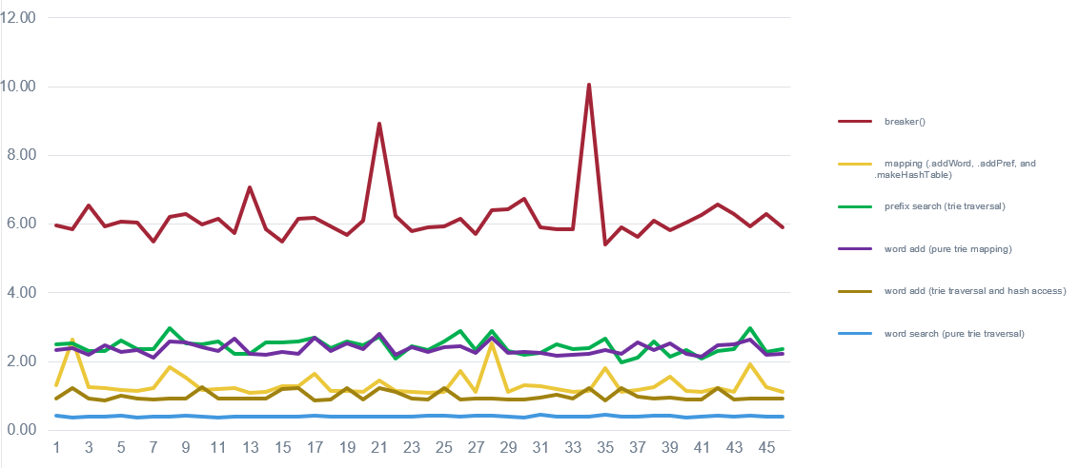
Benchmark Output

Slide 17
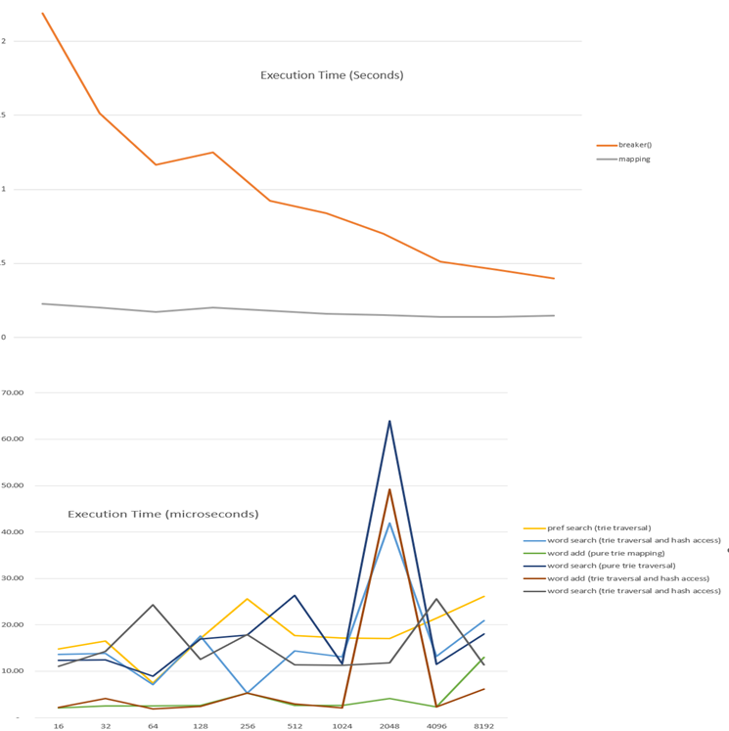
Benchmark Output
Hashtable Size | breaker() (seconds) | Mapping (seconds) | pref search (trie traversal) (micro seconds) | word search (trie traversal and hash access) (micro seconds) | word add (pure trie mapping) (micro seconds) | word search (pure trie traversal) (micro seconds) | word add (trie traversal and hash access) (micro seconds) | word search (trie traversal and hash access) (micro seconds)
16 | 2.19066 | 0.226 | 14.8 | 13.6 | 2.1 | 12.3 | 2.2 | 11.1
32 | 1.51326 | 0.201 | 16.5 | 13.8 | 2.5 | 12.5 | 4.1 | 14.3
64 | 1.16562 | 0.173 | 7.4 | 7.1 | 2.5 | 8.9 | 1.9 | 24.3
128 | 1.25192 | 0.2 | 17.1 | 17.6 | 2.6 | 16.9 | 2.4 | 12.6
256 | 0.922096 | 0.179 | 25.6 | 5.3 | 5.3 | 17.8 | 5.3 | 17.9
512 | 0.840283 | 0.161 | 17.7 | 14.4 | 2.6 | 26.3 | 2.9 | 11.4
1024 | 0.699848 | 0.151 | 17.2 | 13.1 | 2.6 | 11.6 | 2.1 | 11.3
2048 | 0.512504 | 0.14 | 17.1 | 13.1 | 2.4 | 12.1 | 2.2 | 11.8
4096 | 0.456805 | 0.138 | 21.4 | 13.2 | 2.3 | 11.5 | 2.3 | 25.6
8192 | 0.397998 | 0.145 | 26.1 | 20.9 | 13 | 18 | 6.1 | 11.4

Slide 18
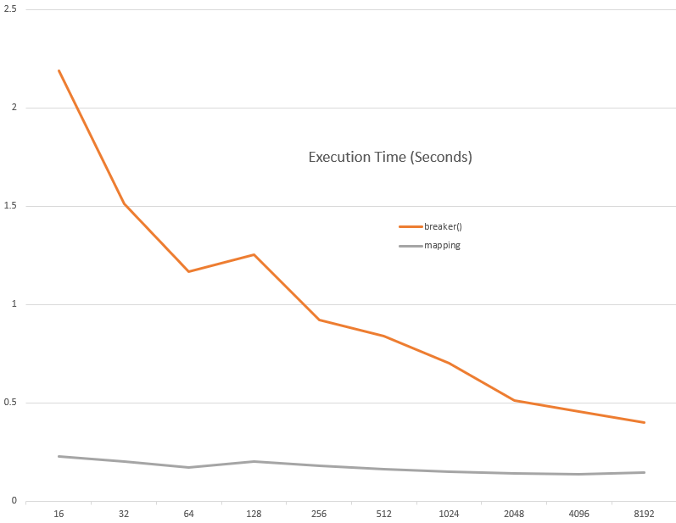
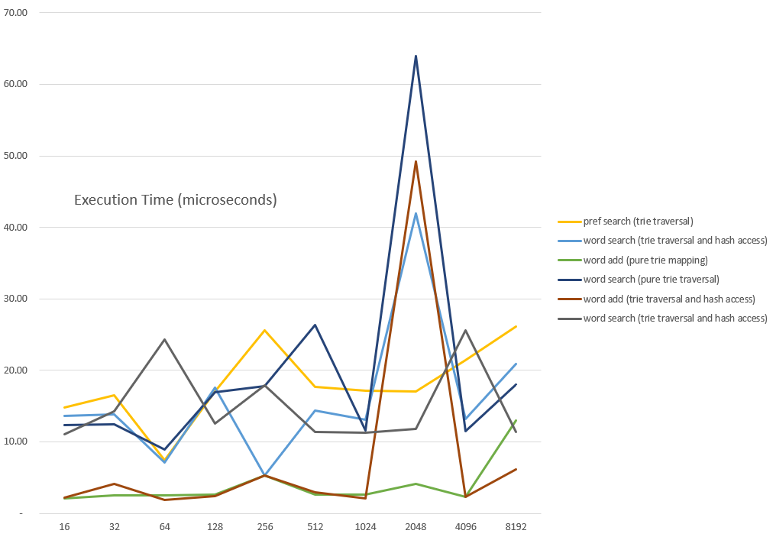
Benchmark Output

Slide 19
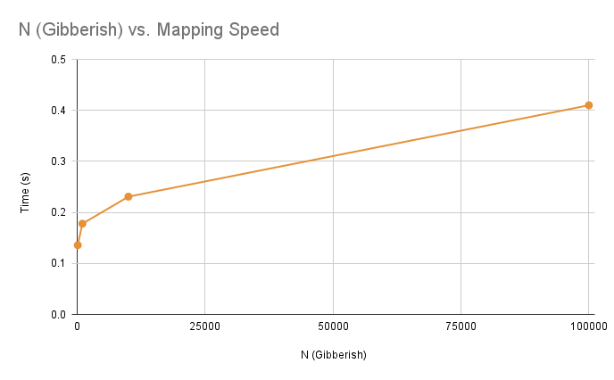
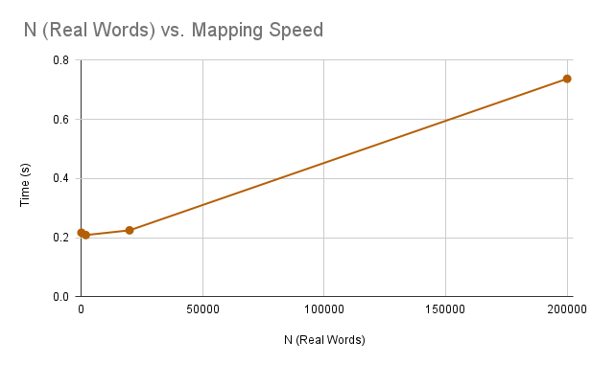
Complexity (Time and Space)
O(√n)<O<O(n)
O(n²)?
In terms of space complexity, the HashTrie is significantly more efficient compared to the Trie:
Trie: Approx 152 MB of space
HashTrie: Approx 13 MB of space*

Slide 20
References
[1] T. Zheng, Z. Zhang, and X. Cheng, “Saha: A string adaptive hash table for analytical databases,” MDPI, https://www.mdpi.com/2076-3417/10/6/1915/htm (accessed May 7, 2023).
[2] K. Tsuruta et al., “C-trie++: A dynamic trie tailored for fast prefix searches,” Information and Computation, https://www.sciencedirect.com/science/article/pii/S0890540121001103 (accessed May 7, 2023).
[3] R. Lasch et al., “Faster &amp; Strong: String Dictionary compression using sampling and fast vectorized decompression - the VLDB Journal,” SpringerLink, https://link.springer.com/article/10.1007/s00778-020-00620-x (accessed May 7, 2023).
[4] P. Bille, I. L. Gørtz, and T. A. Steiner, “String indexing with compressed patterns,” arXiv.org, https://arxiv.org/abs/1909.11930 (accessed May 7, 2023).
[5] J. Lamping and E. Veach, “A fast, minimal memory, consistent hash algorithm,” arXiv.org, https://arxiv.org/abs/1406.2294 (accessed May 7, 2023).

Slide 21
Questions?

